Slide 1

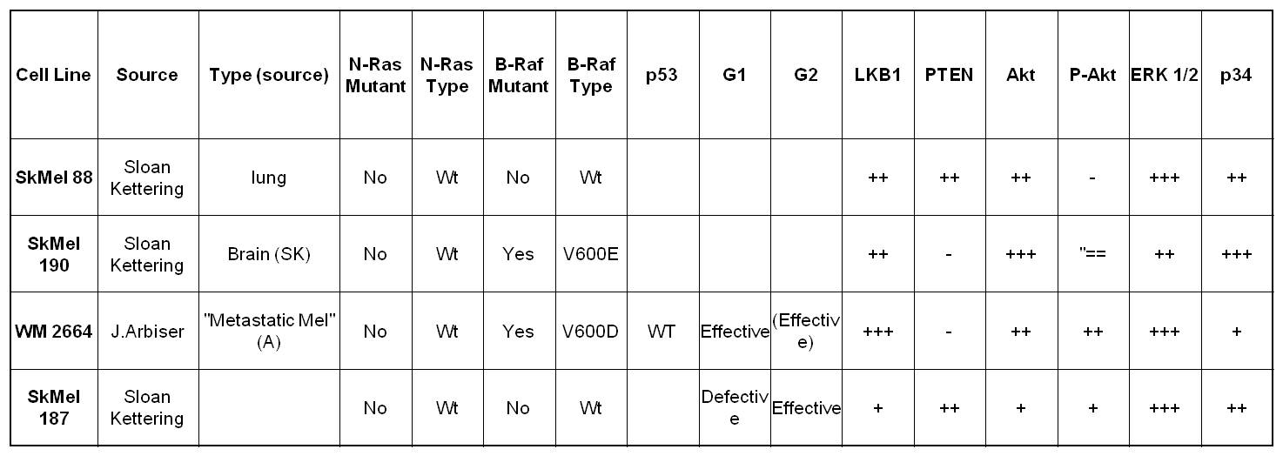
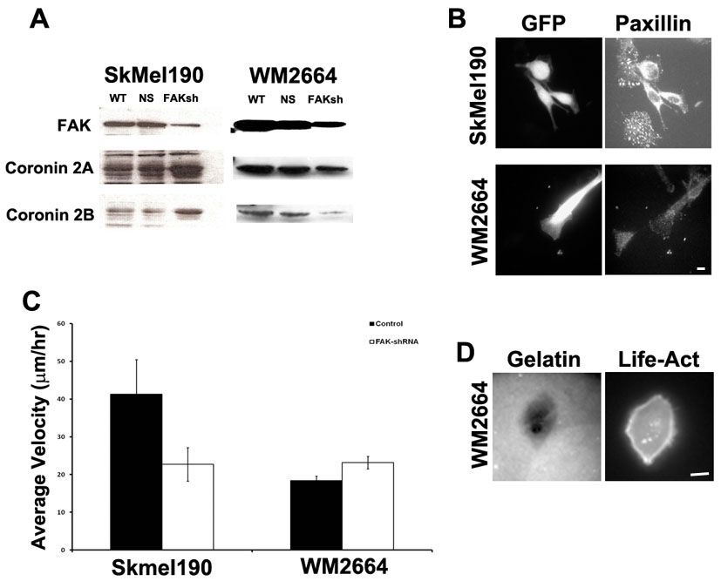
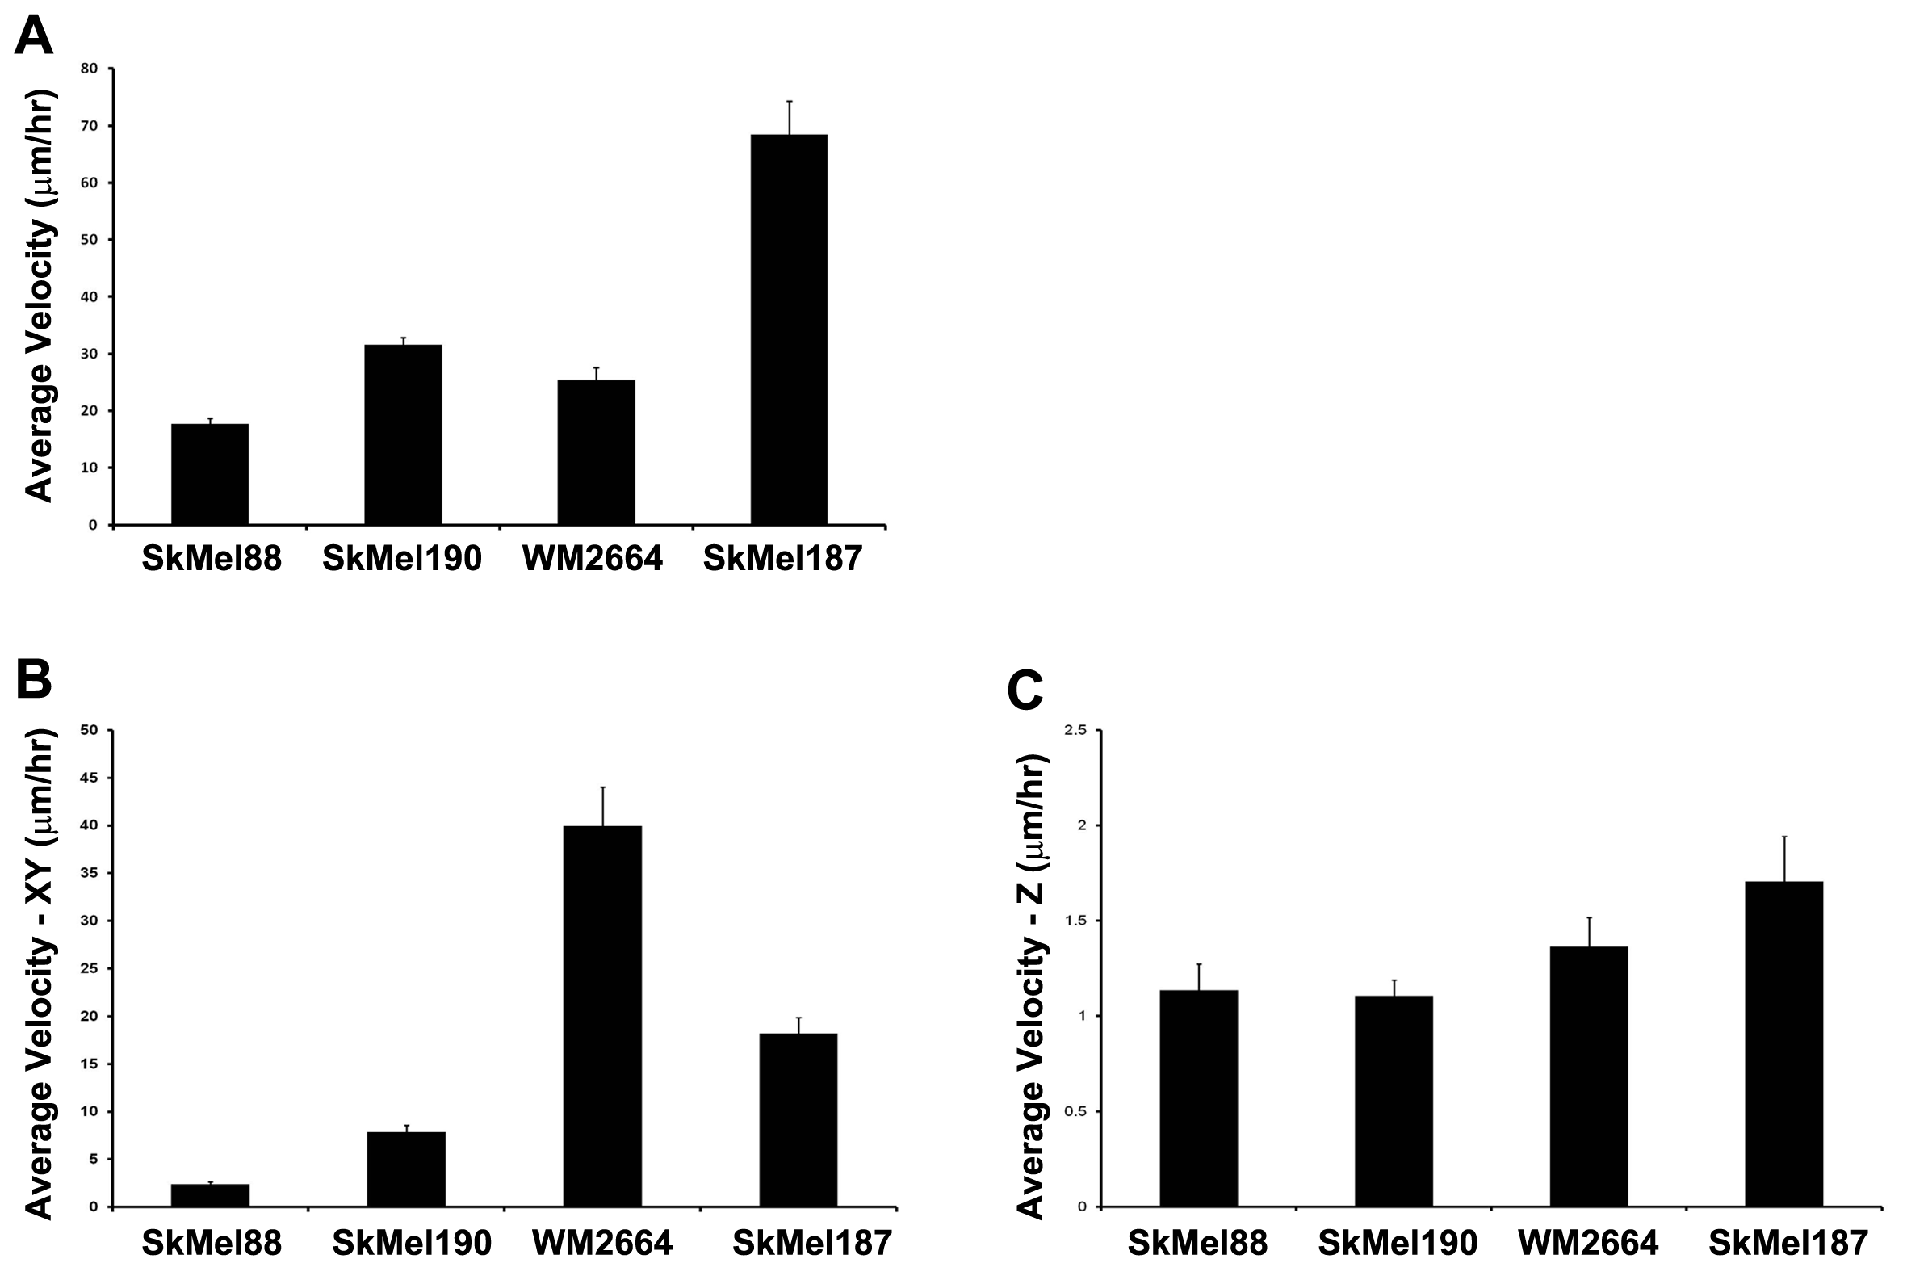
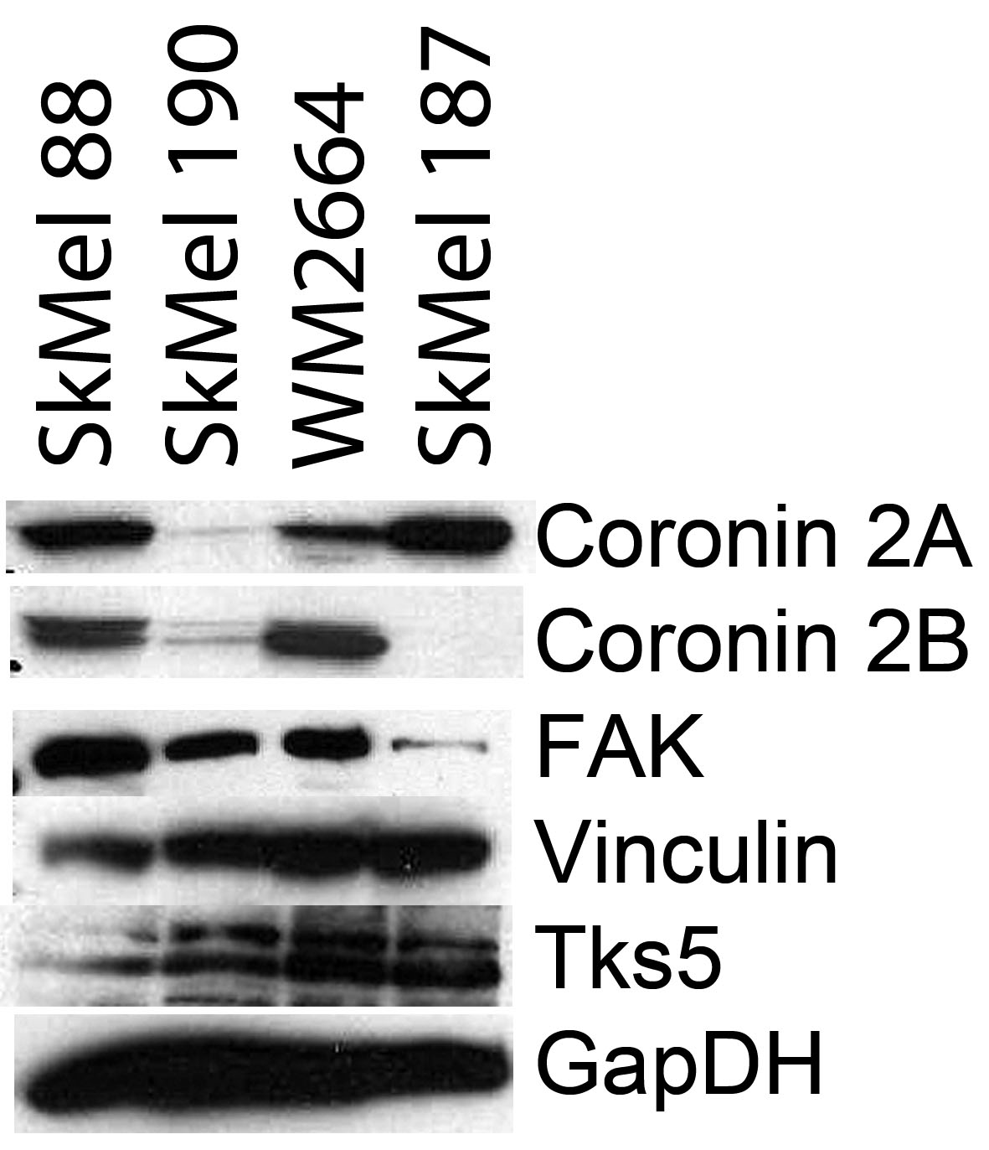
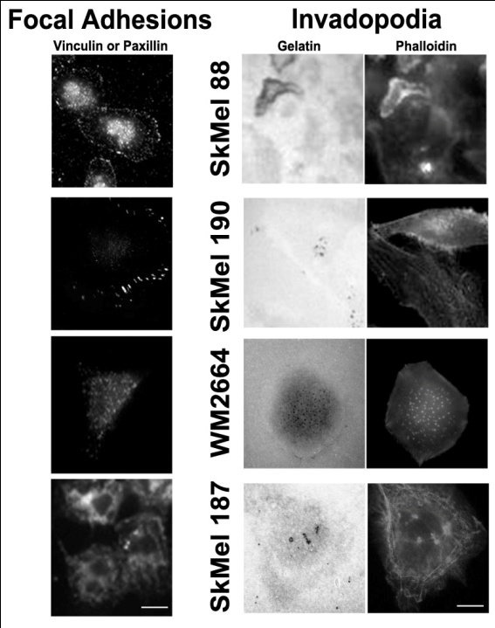
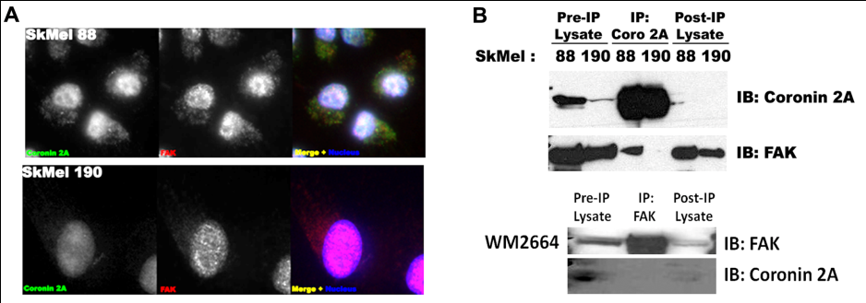
Coronin 2A and Focal Adhesion Kinase in Cellular Migration and Invasion
Sarah J. Creed¹, Matthew Berginsky², Keefe T. Chan^{1,3}, Chris Higgins¹, Heather L. Aloor^{1,3}, David Roadcap¹, Shawn Gomez² and James E. Bear^{1,3}
1. Lineberger Comprehensive Cancer Center and Department of Cell and Developmental Biology, 2. Department of Biomedical Engineering and 3. Howard Hughes Medical Institute, The University of North Carolina Chapel Hill NC USA
ABSTRACT 1189/B419
In 2D culture, cells extend leading edges which weakly adhere to the surface via focal contacts. Focal contacts mature into focal adhesions as the cell reinforces the connection to the extracellular matrix to move itself along. As this occurs focal adhesions at the rear of the cell disassemble as the tail detaches and translocates with the cell body. We previously demonstrated that Coronin 2A plays a role in 2D migration via turnover of focal adhesions. Depletion of Coronin 2A was shown to decrease cell migration and focal adhesion turnover via Cofilin and Slingshot (Marshall, et al., 2009). However, focus is shifting to cellular migration and invasion in 3D, which may more closely resemble migration in the body. Rather than the normal focal adhesions, cells migrating in 3D are more likely to use invadopodia which have both adhesive and matrix degrading properties. During metastasis, a balance between these 2D and 3D migration modes may be essential. We are currently investigating a role for Coronin 2A in mediating this balance. Melanoma cells expressing various levels of Coronin 2A have been investigated in 2D and 3D and the formation of focal adhesions and invadopodia examined. Melanoma cell lines with low expression of endogenous Coronin 2A form large focal adhesions but have decreased capacity to form invadopodia. Conversely melanoma cells that have a higher level of endogenous Coronin 2A form poor focal adhesions but large rosettes of invadopodia. In correlation with this, cells with low Coronin 2A expression exhibit slower migration on 2D surfaces, but an increased capacity to invade into a 3D collagen matrix than those with lower levels of Coronin 2A. Interestingly, cells with high Coronin 2A expression demonstrate an interaction between FAK and Coronin 2A via co-immunoprecipitation which is not seen in cells with lower Coronin 2A expression. Preliminary data suggests that knock down of FAK affects the ability of a cell to form invadopodia. Investigation of the interaction between Coronin 2A and FAK is continuing. From the current data, we hypothesize that the interaction with FAK when Coronin 2A is expressed at high levels plays a role in regulating the balance between focal adhesions and invadopodia.
Table 1: Melanoma Cell Lines. Source, mutation and protein expression information of melanoma cell lines used. Mutation status was previously determined. Protein expression analysis was carried out via Western blot by H. Aloor
RESULTS
Figure 5: FAK knockdown alters focal adhesion formation and 2D motility dependent on type II Coronin expression. A) Western blots demonstrating knockdown of FAK using shRNA. B) Focal adhesions are disrupted in SkMell190 cells following FAK knockdown, but not WM2664 cells. Scale bar = 10μm C) FAK knock down decreases 2D cell motility in SkMel190 cells but not WM2664 cells. n>20cells. D) FAK knockdown is now being examined in cells in 3D. Initial results suggest WM2664 cells for larger invadopodia. Scale bar = 10μm
Figure 1: Protein Expression of Type II Coronins and FAK. The four melanoma cell lines used; SkMel88, SkMel190, WM2664 and SkMel187, provide a full range of type II Coronin expression. Interestingly, SkMel187 cells have very low levels of FAK. Expression of vinculin (a focal adhesion marker) and Tks5 (an invadopodia marker) do not show variance. GapDH is shown as a loading control.
Figure 3: 2D vs 3D Motility. The average velocity of melanoma cell lines. A) 2D motility. Cells plated on fibronectin coated coverslips and tracked through the xy plane. SkMel187 cells move remarkable fast on a 2D surface. B-C) 3D motility. Cells plated within a collagen network and tracked through both B) the xy plane and C) the z plane. The motility of the cells is highly variable between the 2D and 3D culture systems. For all cells lines movement through the z plane was minimal. n>20 cells taken over a minimum of 2 experiments for all conditions, all values are statistically significant in A and B, not significant in C.
CONCLUSIONS
The formation of focal adhesions and invadopodia is altered in cell with different levels of type II Coronin expression.
The motility of cells in both 2D and 3D model systems reflects their ability to form focal adhesions and invadopodia
When Coronin 2A is present at high levels it directly interacts with FAK
Effects of FAK knock down in 2D systems is dependent on type II Coronin expression
Figure 2: Focal adhesion vs invadopodia formation in melanoma cell lines. Focal adhesions were examined by Paxillin or vinculin staining. Invadopodia were examined on fluorescent gelatin. SkMel88 cells form small peripheral focal adhesions but large rosettes of invadopodia. SkMel190 cells form large peripheral focal adhesion and low numbers of small invadopodia. WM2664 cells have small focal and numerous small invadopodia. SkMel187 cells, which have low FAK expression for small puncta of focal adhesion proteins across the entire cell surface and small numbers of invadopodia. Scale bars = 10μm.
METHODS
Four melanoma cell lines (see Table 1) were used to examine type II Coronins and Focal Adhesion Kinase (FAK) in 2D and 3D systems
Protein expression was determined via Western blot analysis
Cells were plated on Fibronectin to examine focal adhesion formation and 2D motility
Coverslips coated with fluorescent gelatin were used to determine invadopodia formation
Motility in 3D was analyzed by embedding single cells in a collagen matrix
FAK shRNA oligo sequences:
F 5’-/5Phos/TGA GGA GAG CAT GAA GCA AGT TCA AGA GAT TTG CAT GCT CTC CTC TTT TTT C -3’
R 5’-/5Phos/TCG AGA AAA AAG AGG AGA GCA TGA AGC AAA TCT CTT GAA CTT GCT TCA TGC TCT CCT CA -3’
Figure 4: Coronin 2A interacts with FAK when both are present a high levels. A) Immunofluorescence staining of Coronin 2A (green) and FAK (red) demonstrate no localization of FAK to the perinuclear area of SkMel88 and SkMel190 cells. Coronin 2A also localizes in this area. Closer localization of Coronin 2A and FAK is observed in SkMel88 cell, which express high levels of Coronin 2A. Images are representative of 3 independent experiments. Scale bar = 10μm. B) Immunoprecipitation demonstrates that FAK and Coronin 2A interact in SkMel88 cells, but not in SkMel190 or WM2664 cell lines. Immunoprecipitation for FAK could not be carried out on SkMel187 cell lines due to the low expression levels of FAK in these cells. Images are representative of 2 independent experiments.
REFERENCES
Marshall, TW, Aloor, HA and Bear, JE (2009) Coronin 2A regulates a subset of focal-adhesion-turnover events through the cofilin pathway. J. Cell Sci. 122(17):3061-69

